Slide 1
6-Axis Robotic Arm
McMaster BTech Capstone 2026
Taking Jobs, One Arm at A Time

Slide 2

Dream

Slide 3



QUINN SHEPPARD
Experience: Cast of MEM, Media Lead for McMaster Steel Bridge
Skills: Organization, Creativity, Electrical Design
True Colours: Gold (28%), Green (28%)
ABDULLAH ABOUTAHA
Experience: Supply Chain Intern @ PepsiCo
Skills: Software Architecture, Web Programming, Control System Implementation
True Colours: Blue (55%), Green (45%)
MARCUS J CAMERON
Experience: Controls Design and Integration, Industrial PLC programming and Vision System programming
Skills: Additive Manufacturing, Design and Programming
True Colours: Green (39%), Blue (21%)

Slide 4
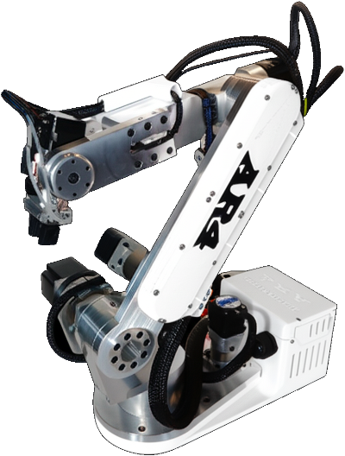
Project Overview
GOAL:
Design and implement a 6-DOF robotic arm with a custom teach pendant interface.
System includes: UI (web) -> bridge.py -> USB serial -> Arduino
mega -> motors
Mechanical structure
Microcontroller based control
Web-based teach pendant UI
Wifi capable communication architecture
Source: Anin Robotics – https://aninrobotics.com

Slide 5
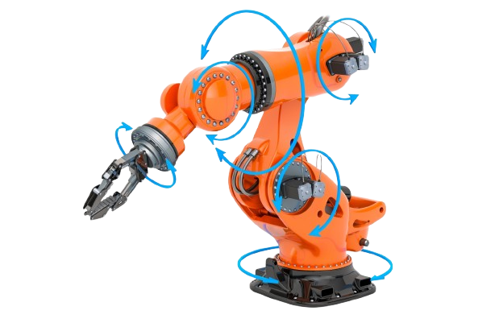
Project Description / Objectives
Design and implement a teach-pendant controlled robotic arm capable of manual joint positioning and teach and repeat operations
Integrate mechanical design, motor control, and sensors to enable precise joint control and trajectory
Validate the system through repeatable sequence demonstrations appropriate for educational and worship environments

Slide 6
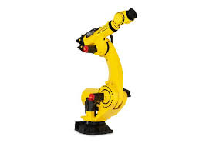
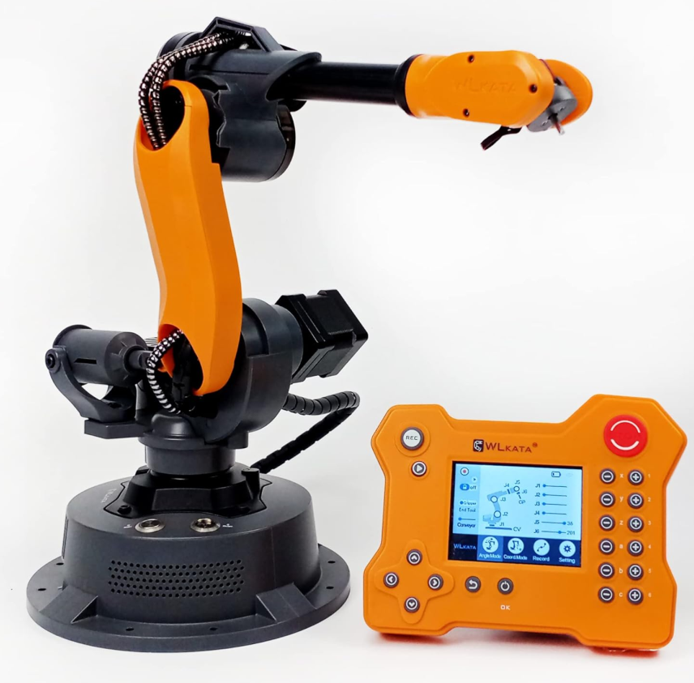
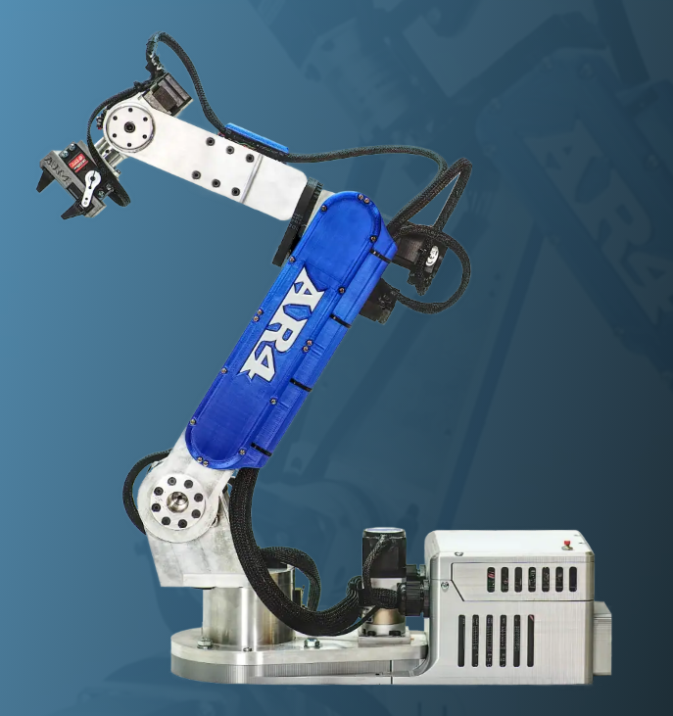
Similar Products
FANUC Robot
Expensive
Lots of features
WLKATA Microbot
Expensive
Wireless Teach Pendant
AR4
$1,329
Build it your own

Slide 7
Software Alternatives
Option 1 : Direct Desktop serial control (PyQt + PySerial over USB)
UI directly communicates with arduino
Simple architecture
Good for early testing
Tightly coupled to UI hardware
No remote/network control
Option 2 : Structured JSON Protocol
Uses structured commands (ID, POS, SPEED)
Uses HTTP POST (Send) and GET to retrieve motor status
Clean separation between UI and hardware
Supports future Wi-fi integration

Slide 8
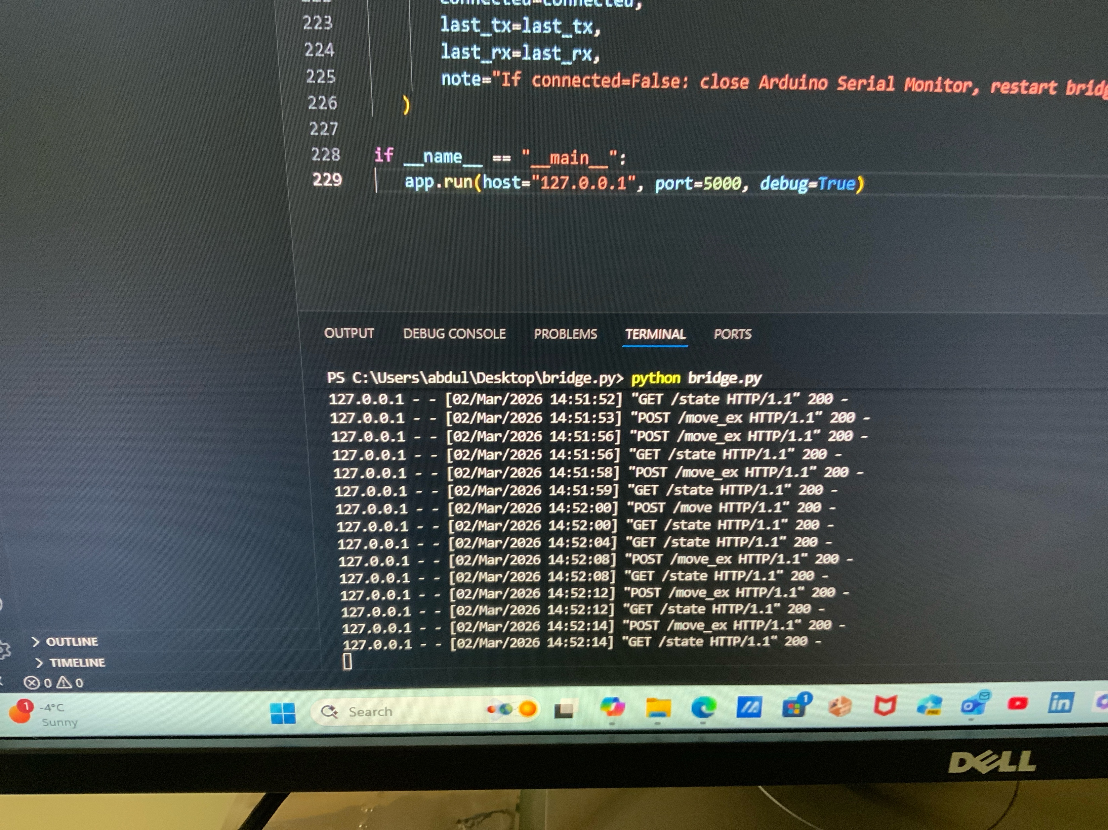
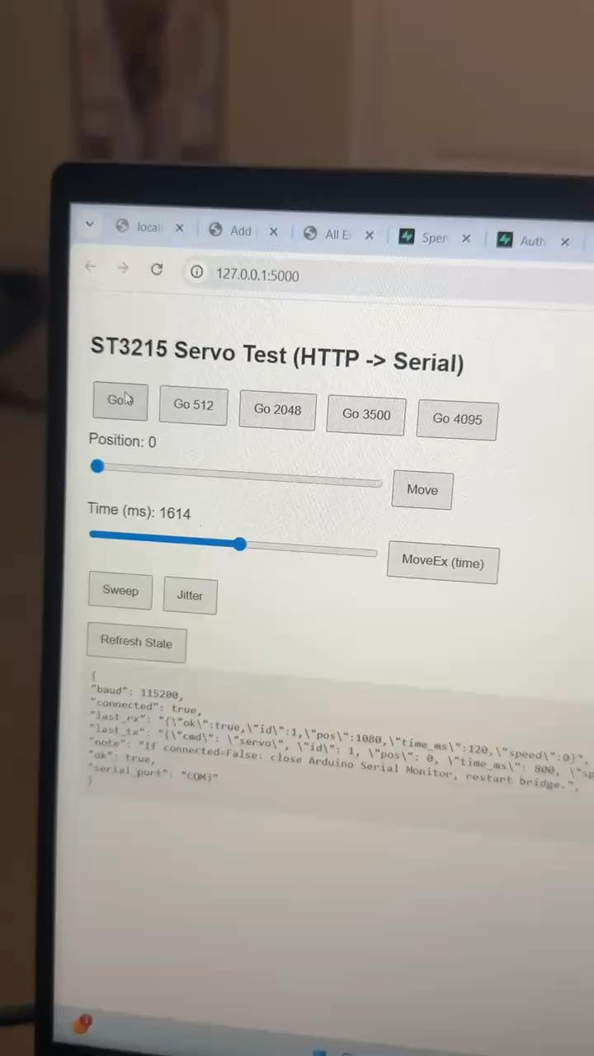
Post/Get Commands (Servo Testing)

Slide 9

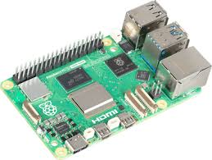
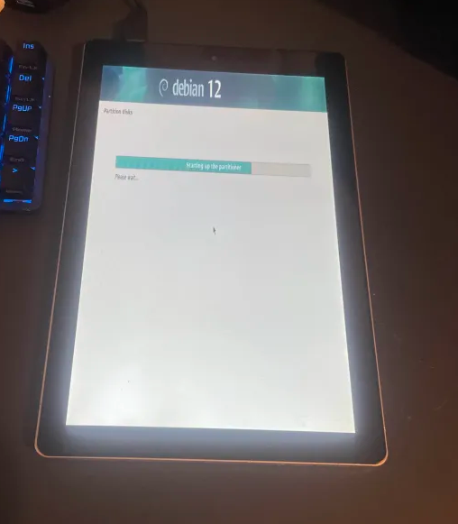
Teach Pendent Alternatives
Primary Device | Screen | Buttons | Connection
Raspberry Pi | Old Laptop Screen | All Touch Screen | Bluetooth
Old Tablet | Build into Tablet | All Touch Screen except emergency stop | WiFi
Raspberry Pi Remotely connected | Touch Screen | Physical Buttons with display | Wire

Slide 10
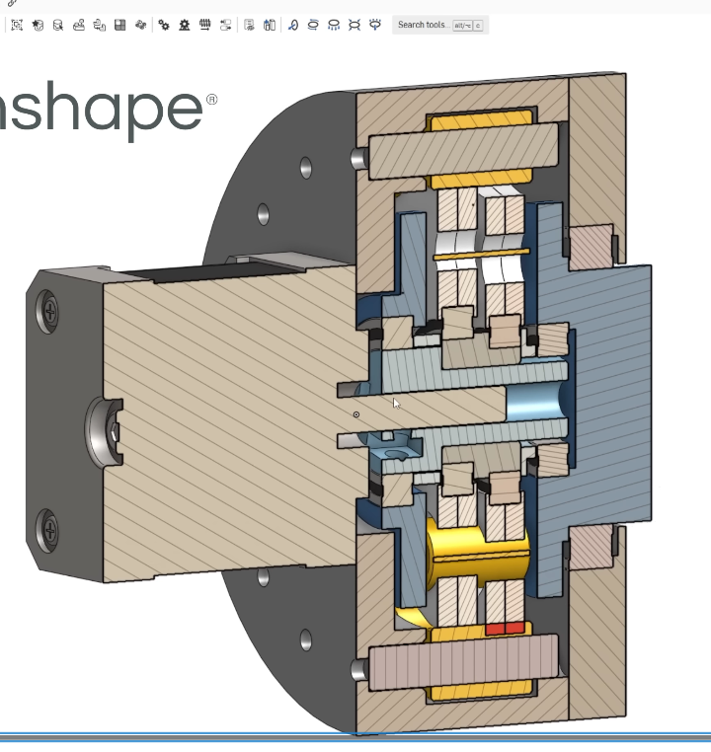
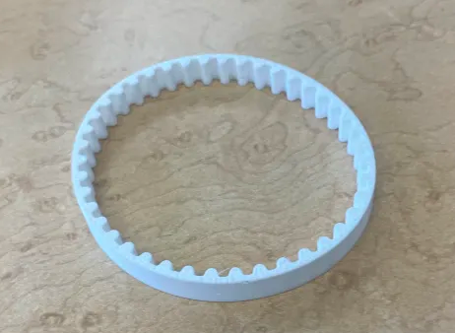
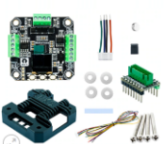
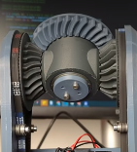
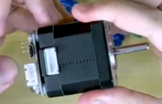
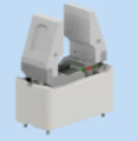
Mechanical Alternatives

Slide 11
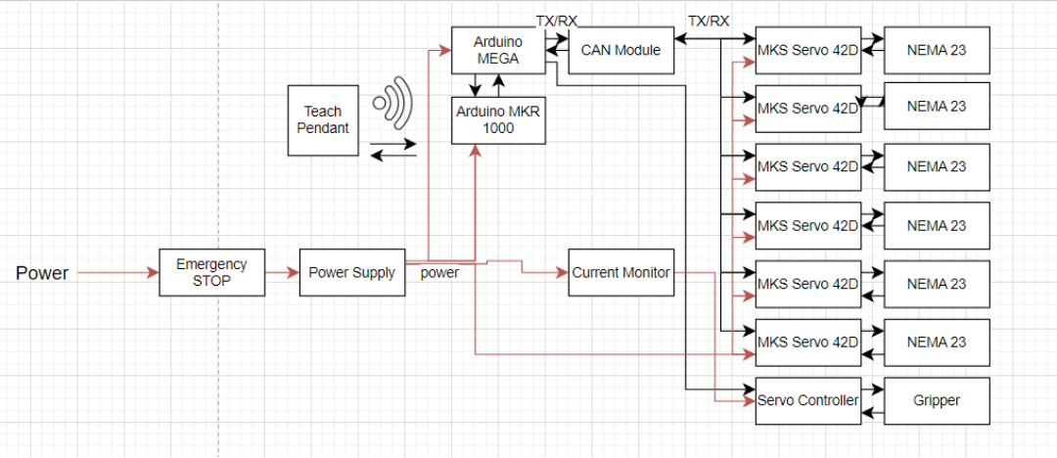
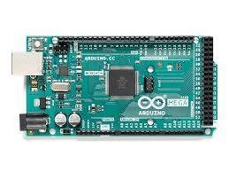
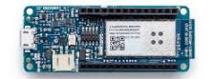
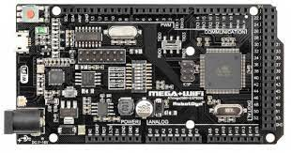
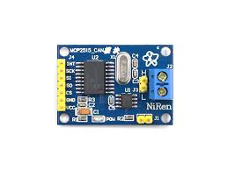
Block Diagram
Controller area network

Slide 12
Project Timeline
January 12th: Define Project Proposal & Presentation Started (Complete)
January 20th: Project Proposal Presentation Complete & Report Reviewed/Submitted (Complete)
January 27th: Research Alternatives (Complete)
February 3rd: Final system architecture selected (M/E/S) (Complete)
February 10th: Software Communication planned and Midterm Presentation and Report Complete (Complete)
February 24th: Midterm Presentation Practiced & Report Reviewed/Submitted (Complete)
March 3rd: Create Part List, Budget, Defined microcontroller and servo communication (Complete)
March 10th: Project Design (AutoCAD, Fusion 360, Inventor, etc.), initial serial communication prototype (PC to microcontroller)
March 17th: Project Design (AutoCAD, Fusion 360, Inventor, etc.), Implement JSON-based command protocol.
March 24th: Create Final Presentation & Report, put together different team member’s work (Electrical, Mechanical, Software) Begin multi-servo scalability testing with UI.
March 31st: Presentation and Final Report Complete ready for review
April 7th: Final Presentation Practiced & Report Reviewed/Submitted

Slide 13
End of semester 1 target
Validate control architecture
Finalized mechanical design
Testing multi motor integration with software (UI)
Complete integration and wiring plan
Semester 2:
Focused on fabrication, assembly and full system testing!

